Slide 1

Semsary
Graduation Project - Part I
The Management Intelligent System
For Managing Individuals' Residence in Cities

Slide 2
Our team
Mohamed Badawy Sayed
Mostafa Ahmed Hasan
Mahmoud Ahmed Khalil
Ahmed Nageh Abbas
Nada Maaman Abdel Karim
Basant Benyamen Barsoum

Slide 3
Table of contents
01
02
03
Abstract
06
System UI
problem statement
07
Use Case Diagram
overview
08
System Architecture
04
objectives
09
Techniques and tools
10
References
05
Related Works

Slide 4
01
Introduction
Semsary

Slide 5
Abstract
Semsary is a web-based rental management system built to simplify rental processes for tenants, landlords, and families. It consolidates reliable rental, automates price assessments, and ensures secure booking.
Semsary uses machine learning to ensure fair rental pricing and market transparency while minimizing fraud. It offers advanced filters for apartment searches, verified reviews, and location-based insights to support informed decisions. It also recommends apartments based on user behavior.

Slide 6
problem statement
scams and fraudulent activities in the rental process.
Insufficient information about apartment features.
Challenges in finding apartments that align with individual preferences and needs.
Limited marketing exposure for quality apartments.
Difficulty in establishing direct and effective communication with landlords.
Lack of consistency in financial transactions during the rental process.

Slide 7
overview
Providing credibility of apartment information.
Providing all the information the tenant needs to make a decision.
Display apartment ads that suit each tenant's preferences individually.
Effective display of apartments for their target audience.
Ensuring security in financial dealings for the owner and the tenant.

Slide 8
objectives
Connecting landlords with the largest number of potential tenants for their apartments.
Facilitating the rental process for tenants.
Providing knowledge of the fair price of the apartment.
Providing a safe and reliable environment for renting between the landlord and the tenant.

Slide 9
02
Related Works
Semsary

Slide 10

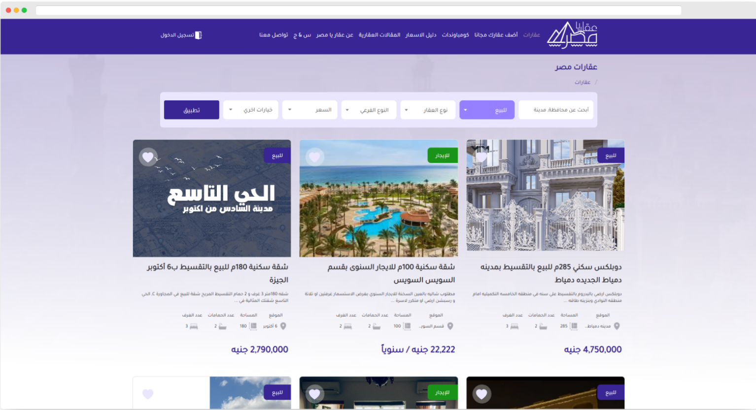
Related Works
Aqaryamasr

Slide 11

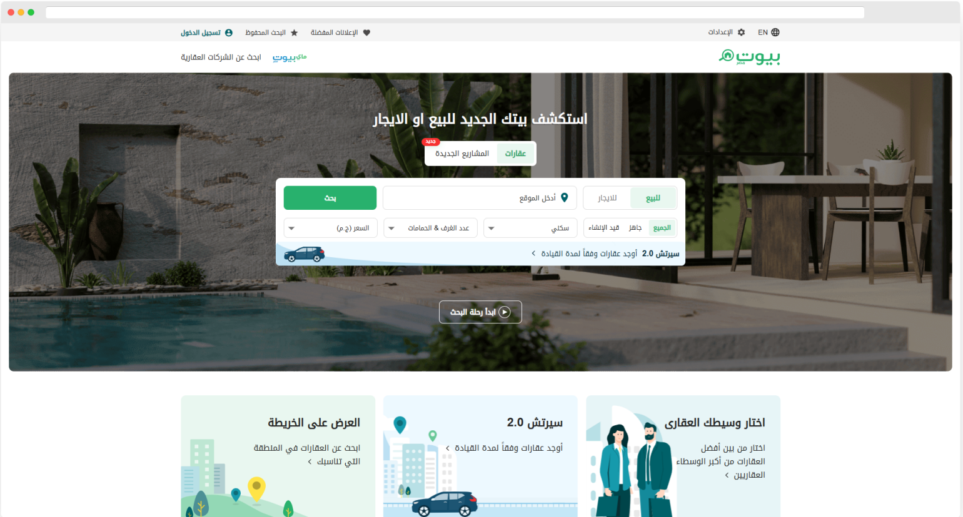
Related Works
Bayut

Slide 12

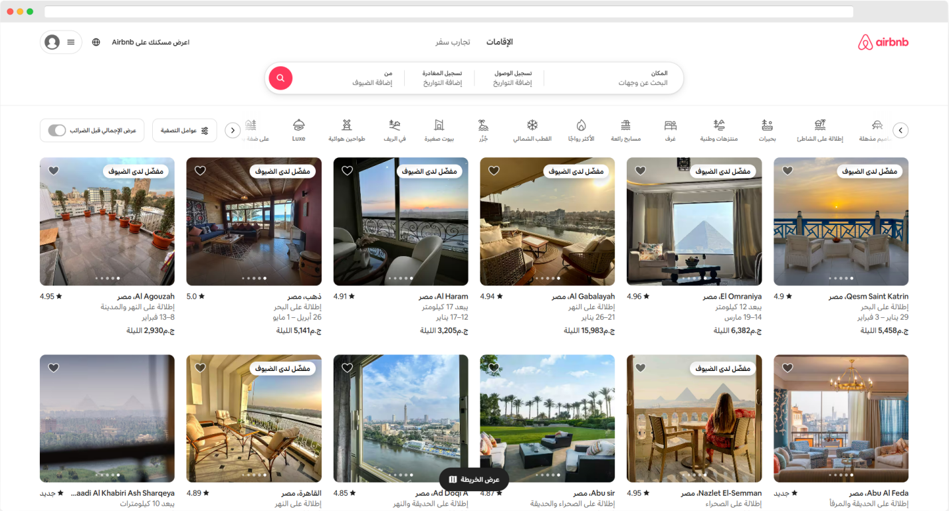
Related Works
Airbnb

Slide 13
03
System UI
Semsary

Slide 14
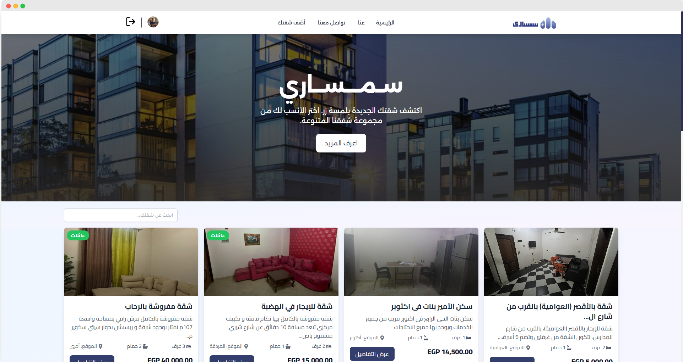
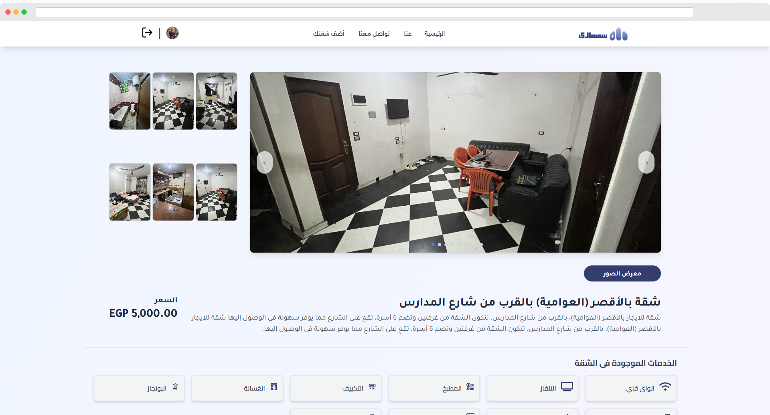
System UI
Home Page
Apartment details

Slide 15
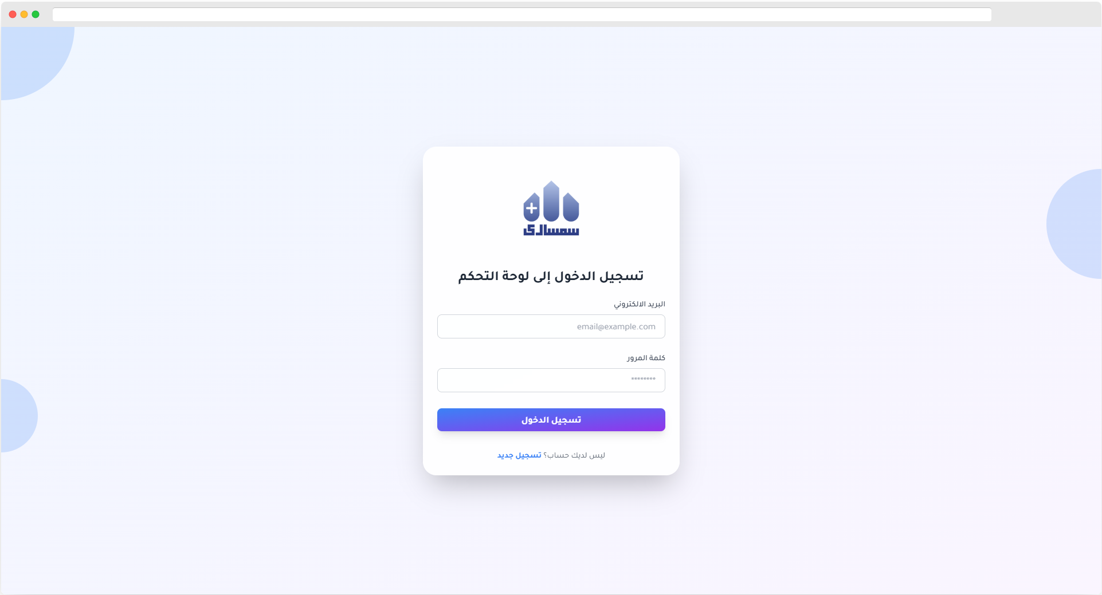
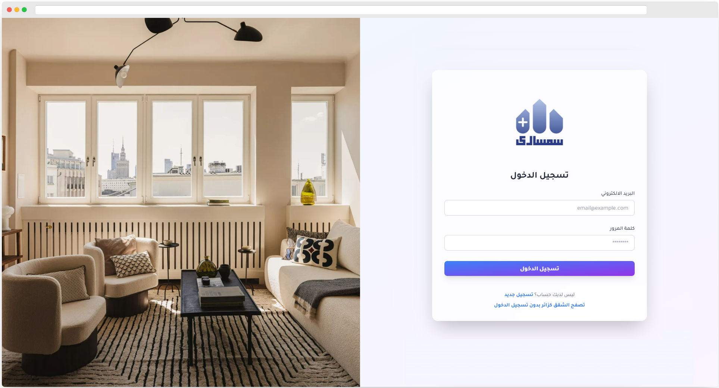
System UI
Admin Login
Users Login

Slide 16
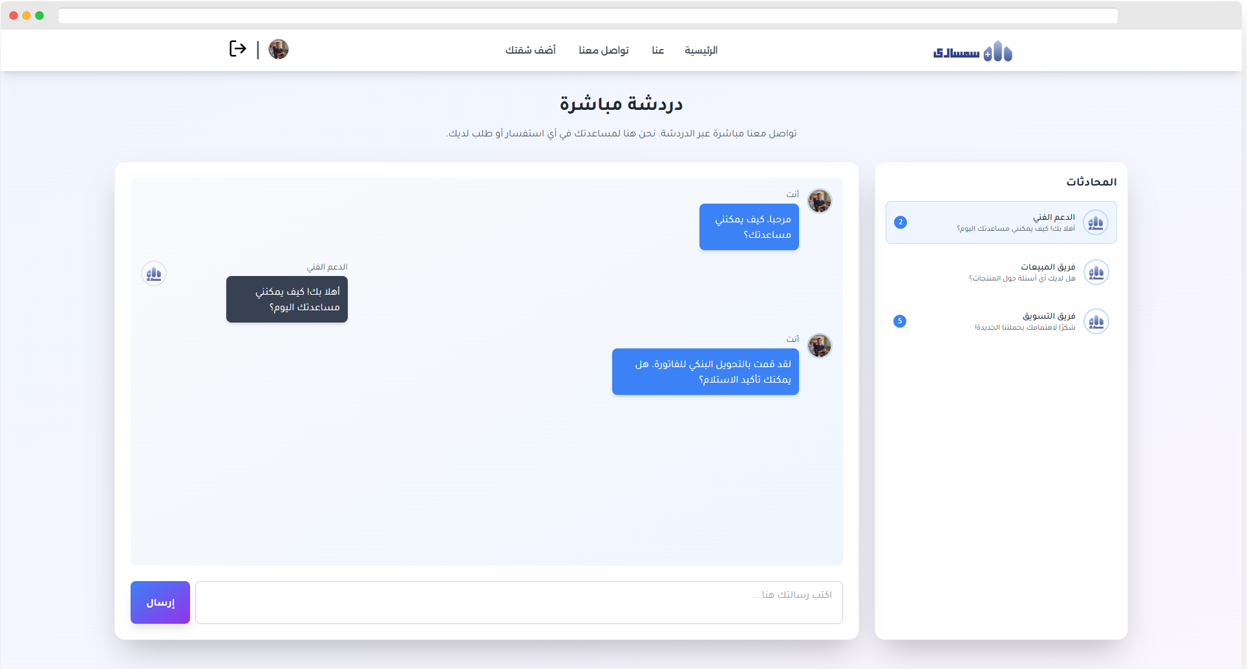
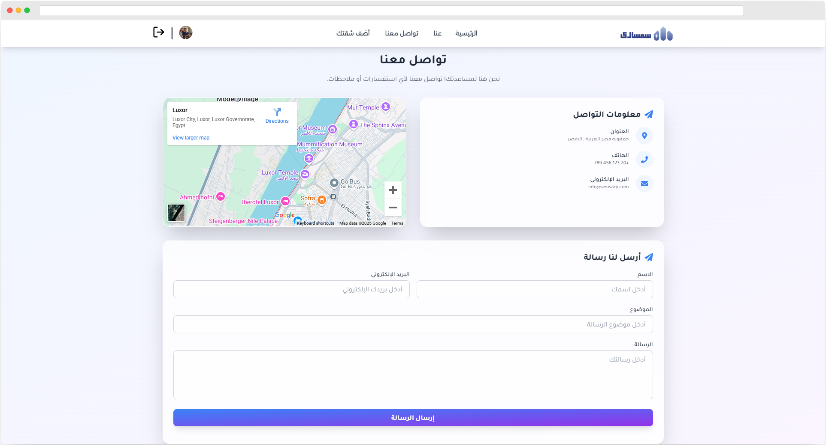
System UI
Conversations
Contact Us page

Slide 17
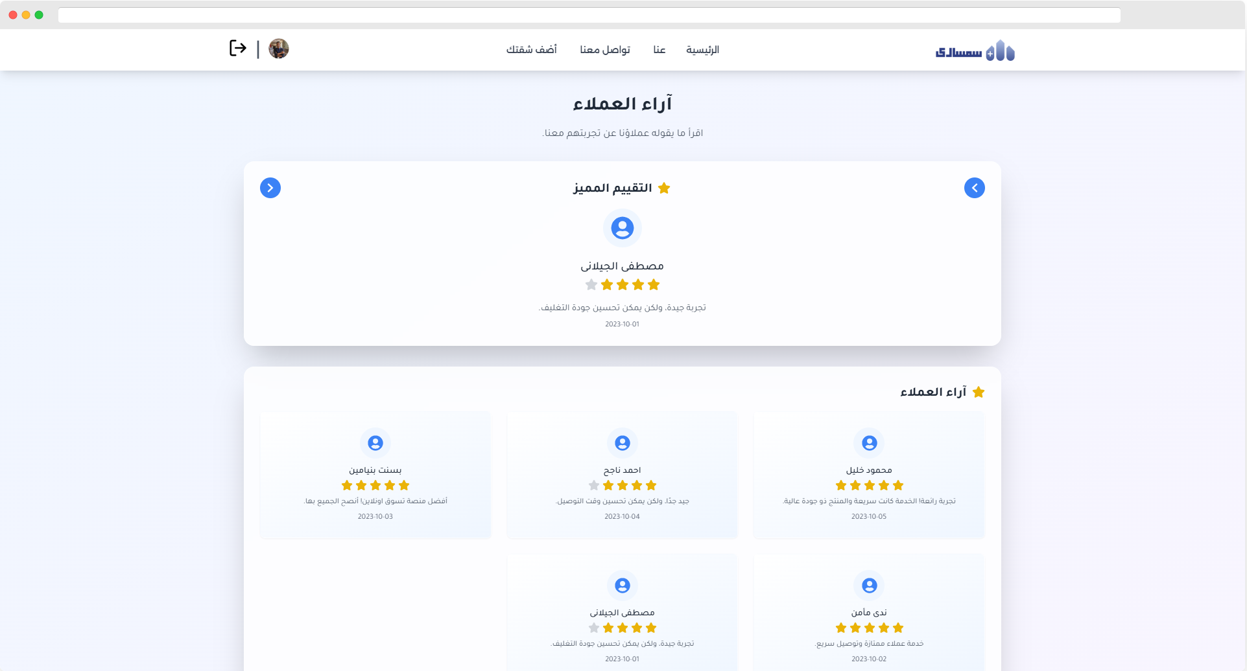
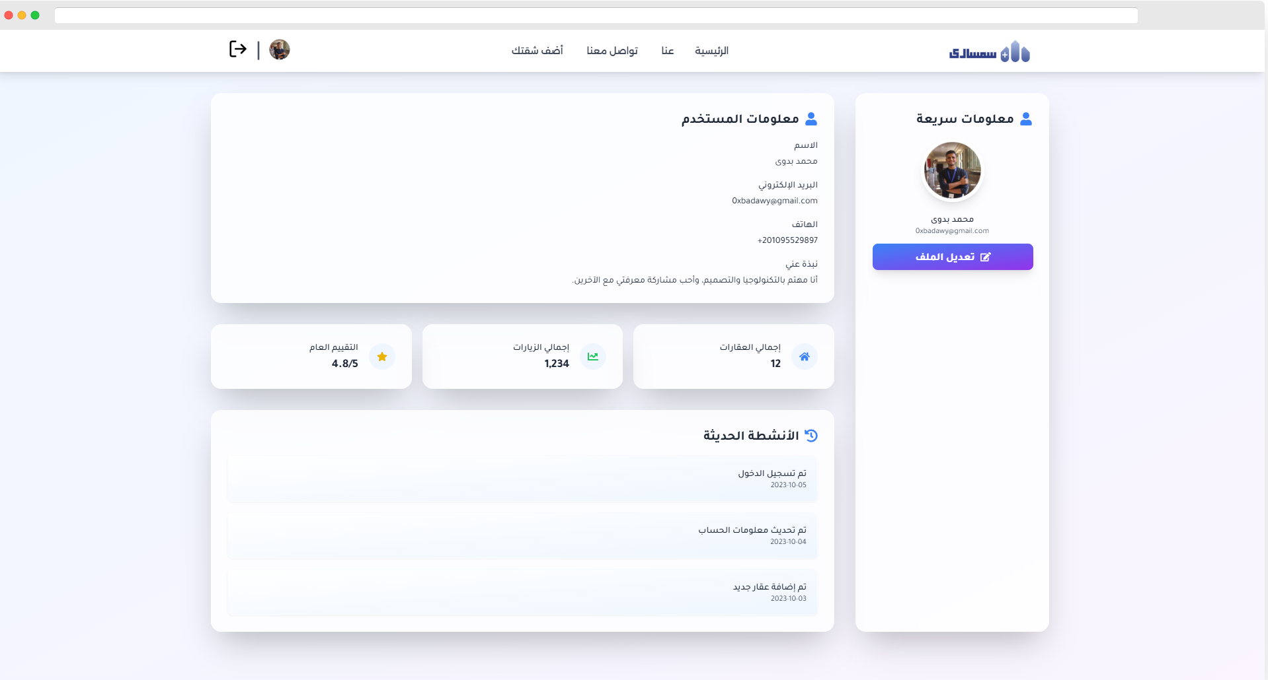
System UI
User reviews
Profile Page

Slide 18
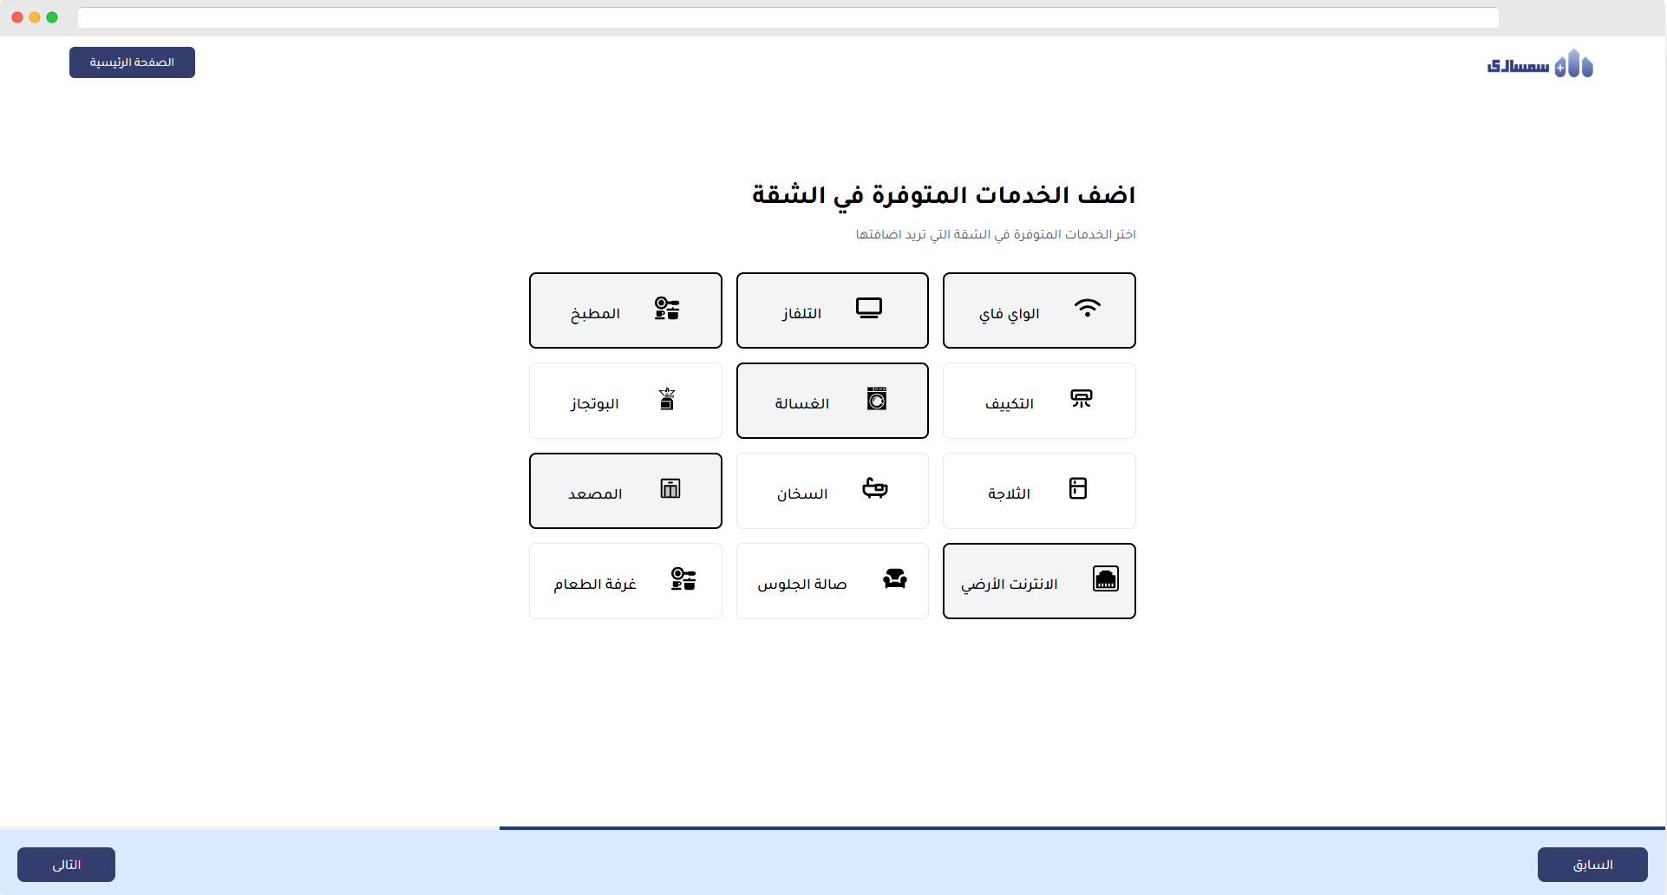
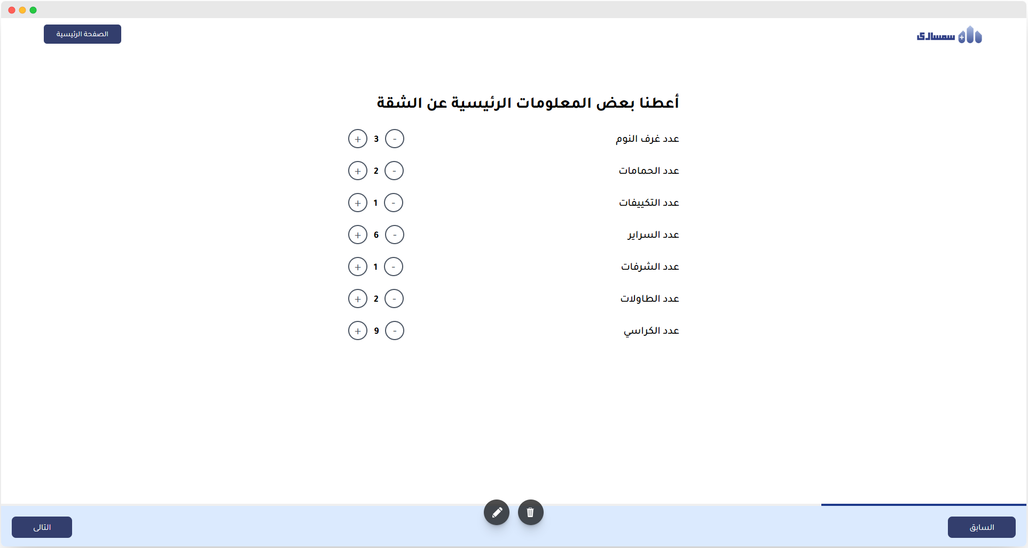
System UI
Add Apartment
Add Apartment

Slide 19
04
Use Case
Semsary

Slide 20
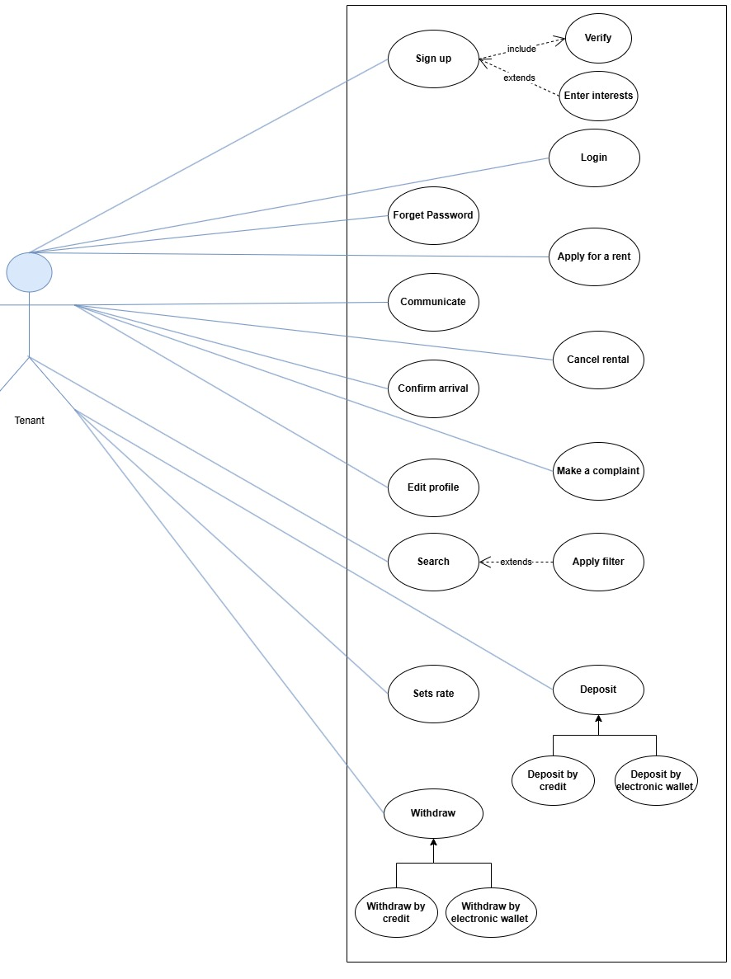
Use Case Diagram
tenant use case

Slide 21
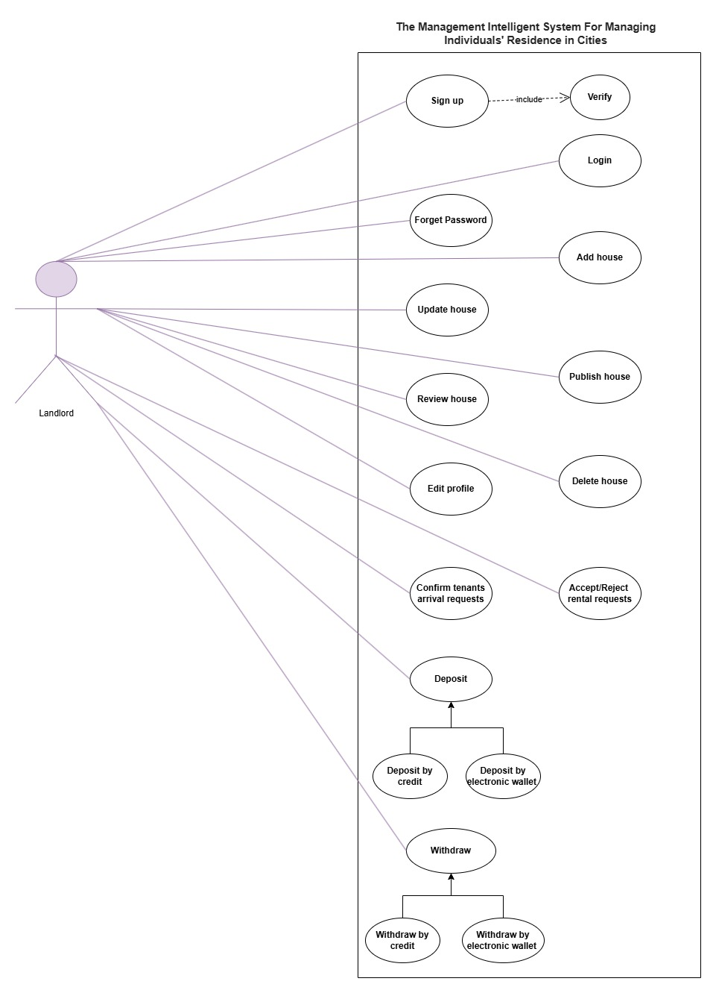
Use Case Diagram
landlord service

Slide 22
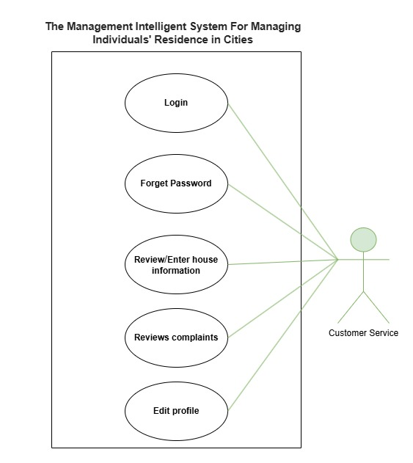
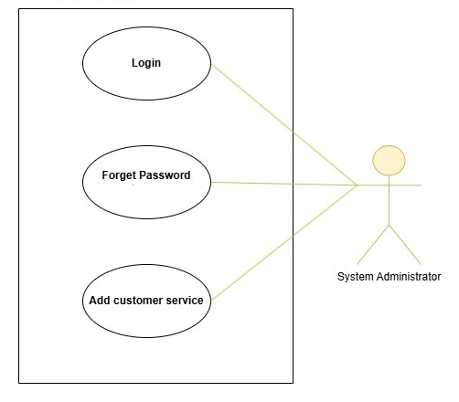
Use Case Diagram
customer service
system administrator

Slide 23
05
System Architecture
Semsary

Slide 24
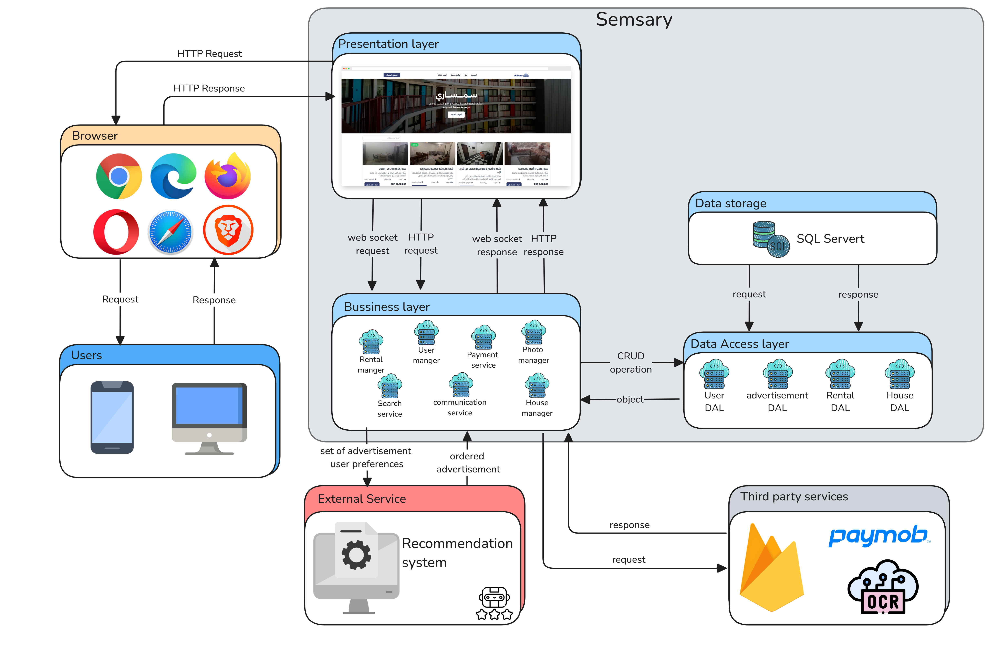
System Architecture

Slide 25
06
Data Collection
Semsary

Slide 26
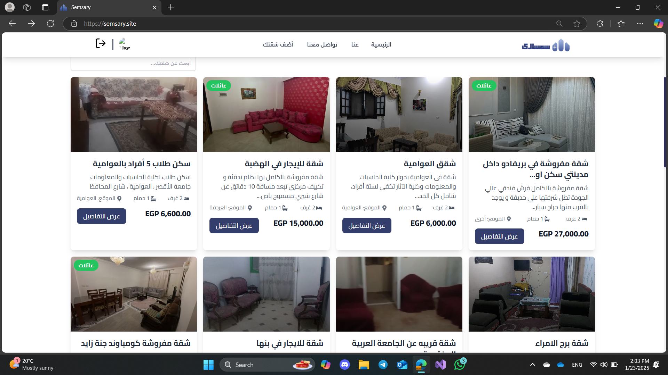
Data Collection

Slide 27
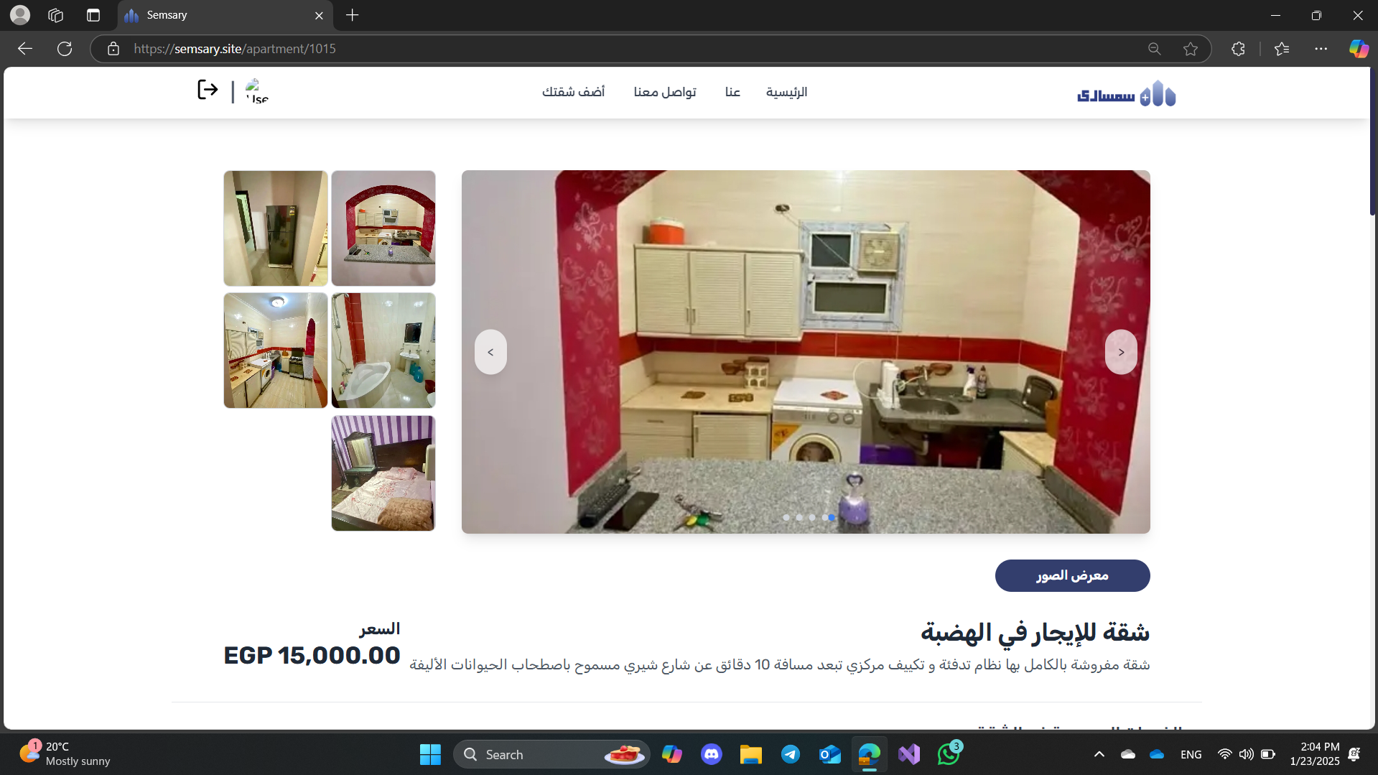
Data Collection

Slide 28
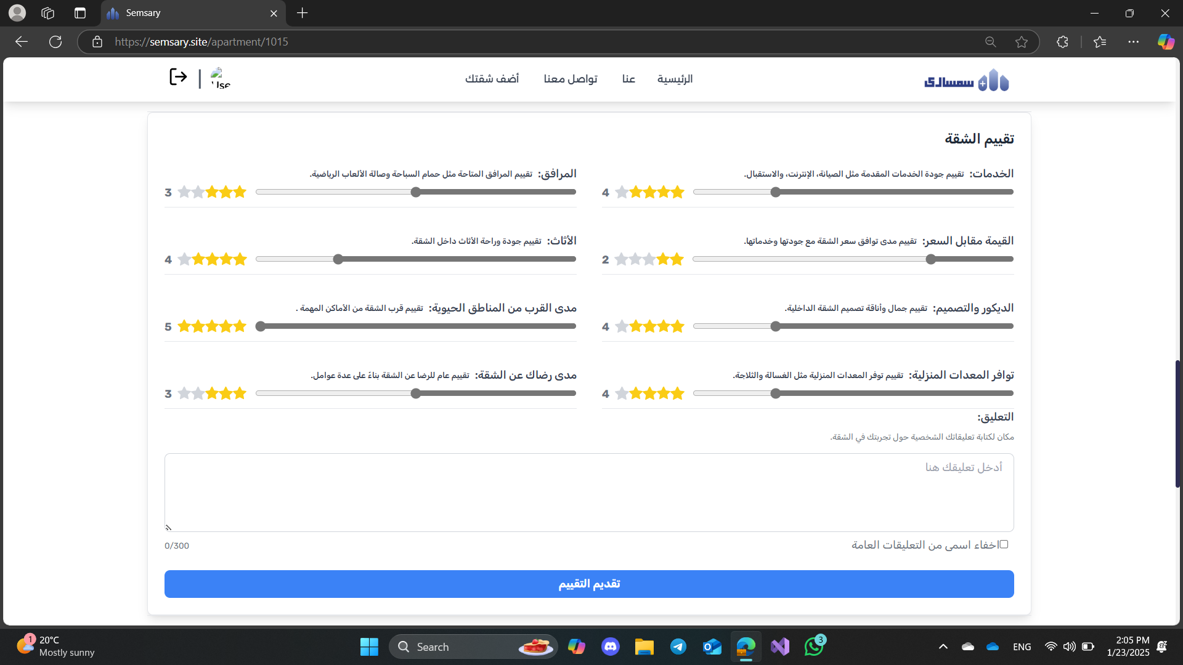
Data Collection

Slide 29







Techniques and tools
Machine Learning TensorFlow
Frontend
React JS
Backend
. NET

Slide 30
References
1. Airbnb. [Online]. URL: https://www.airbnb.com (Available at: December 1, 2024)
2. Bayut. [Online]. URL: https://www.bayut.com (Available at: December 1, 2024)
3. Aqary Masr. [Online]. URL: https://aqaryamasr.com (Available at: January 21, 2025)

Slide 31
Thanks!

